Slide 1
SMART WATER FOUNTAIN

Slide 2
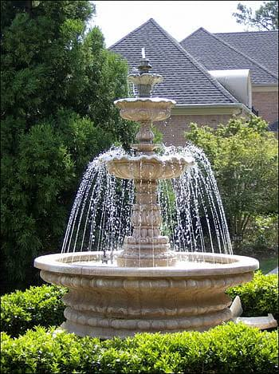
ABOUT SMART WATER FOUNTAIN
Smart water fountains are innovative devices combine water filtration with advanced technology. They offer touchless, hands-free operation and often feature sensors for user interaction and maintenance alerts. Connectivity options enable remote monitoring, data analytics, and customization. These fountains are ideal for environments like offices and public spaces, promoting water quality, hygiene, and sustainability. They also encourage the use of reusable containers, reducing the need for single-use plastic bottles.

Slide 3
objectives
Water Conservation: Smart water fountains are designed to conserve water by minimizing wastage. They can include sensors and controls to ensure that water is only dispensed when needed, such as when a user approaches the fountain or activates it.
Sustainability: Many smart water fountains are designed with sustainability in mind. They may use energy-efficient components, be made from eco-friendly materials, and incorporate features like solar power or energy-saving modes to reduce their environmental impact.
Safety and Sanitation: Smart water fountains can include features to enhance safety and sanitation, such as automatic disinfection systems or sensors to detect maintenance needs.

Slide 4
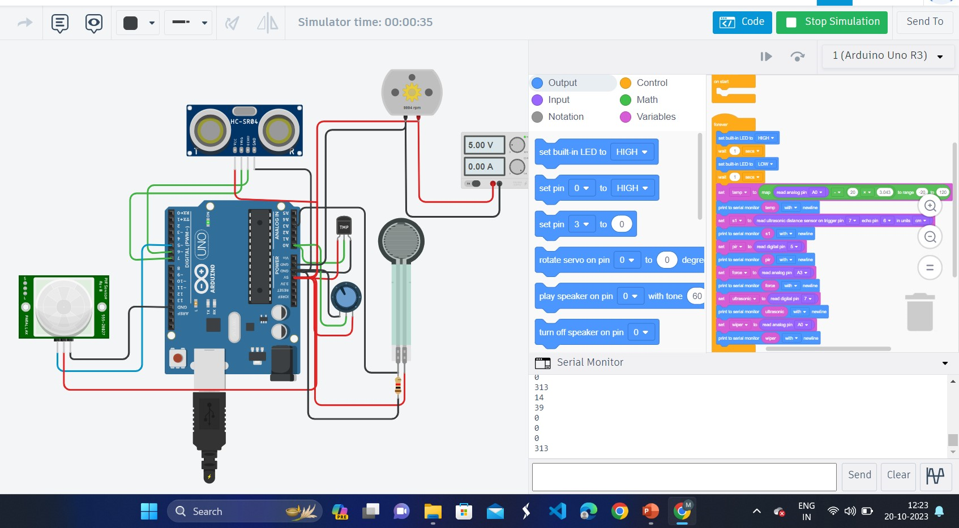
IOT SENSOR SETUP

Slide 5
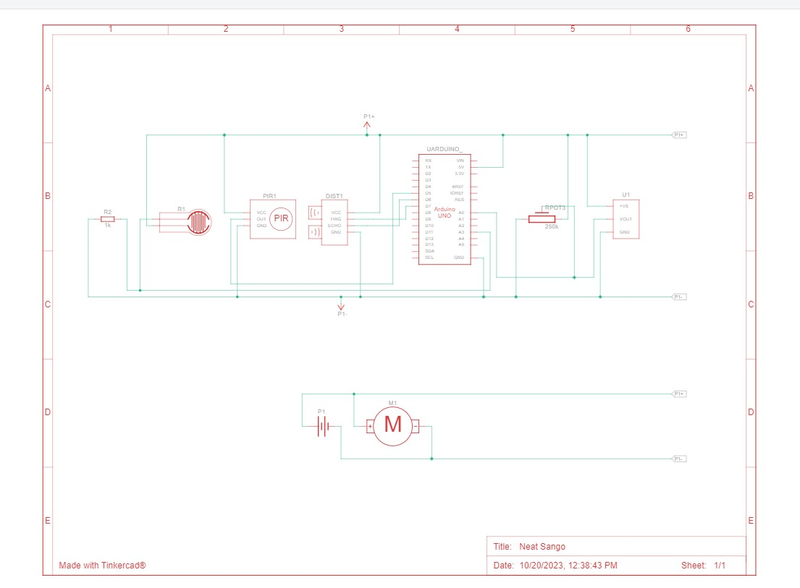
SCHEMATIC DIAGRAM

Slide 6
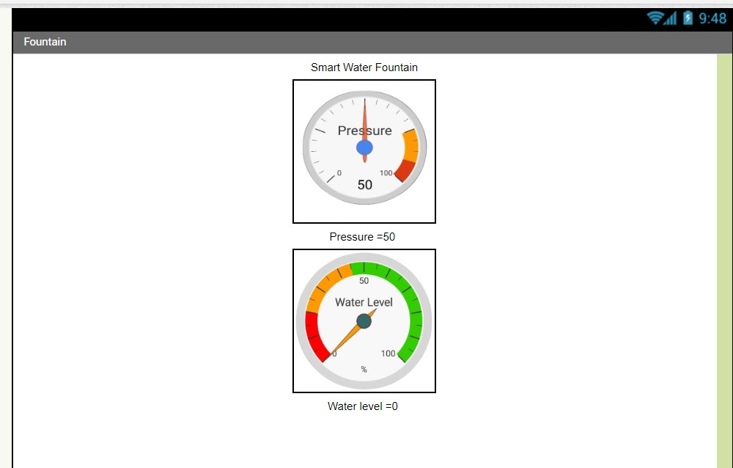
MIT APP INVERTER

Slide 7
code
from machine import Pin, ADC
import time
temp = 0
s1 = 0
pir = 0
force = 0
ultrasonic_sensor = 0
wiper = 0
ulrasonic = 0
def read_ultrasonic_distance(trigger_pin, echo_pin):
trigger = Pin(trigger_pin, Pin.OUT)
trigger.value(0)
time.sleep_us(2)
trigger.value(1)
time.sleep_us(10)
trigger.value(0)
echo = Pin(echo_pin, Pin.IN)
return echo.pulse_time(1, timeout=1000000) # 1-second timeout
# Set up the pins
led_builtin = Pin(2, Pin.OUT) # For NodeMCU, typically built-in LED is on pin 2

Slide 8
temp_sensor = ADC(0)
pir_sensor = Pin(5, Pin.IN)
force_sensor = ADC(0)
ulrasonic_sensor = Pin(7, Pin.IN)
# Initialize the serial communication
uart = machine.UART(0, baudrate=9600)
os.dupterm(uart)
while True:
led_builtin.value(1)
time.sleep(1) # Wait for 1 second
led_builtin.value(0)
time.sleep(1) # Wait for 1 second
temp = int(((temp_sensor.read() - 20) * 3.043) / 1023 * 100)
print(temp)
s1 = int(0.01723 * read_ultrasonic_distance(0, 0) / 58) # Convert microseconds to centimeters
print(s1)
pir = pir_sensor.value()
print(pir)
force = int(force_sensor.read())
print(force)
ulrasonic = ulrasonic_sensor.value()
print(ulrasonic)
wiper = int(temp_sensor.read())
print(wiper)

Slide 9
PUBLIC USES
Tourist Attractions: Tourist destinations may have smart water fountains to cater to the needs of visitors and ensure a positive experience.
Sustainability Initiatives: Smart fountains that promote water conservation and sustainability can be part of a city's or organization's broader environmental efforts
Homeless and Vulnerable Populations: In some areas, smart water fountains have been installed to provide a source of clean water for homeless and vulnerable populations.
Public Health Initiatives: Public health campaigns may use smart water fountains to promote drinking water as a healthier alternative to sugary beverages. These fountains can display health messages and tips.

Slide 10
THANK YOU

